Slide 1

Interfacing Ultrasonic Sensors with Beaglebone Black
Submitted By: Submitted To:
Manavdeep Singh Prof. Mike Aleshams
C0751407

Slide 2

IOT Enabled Beaglebone Based Smart Parking System with SMS Alert

Slide 3
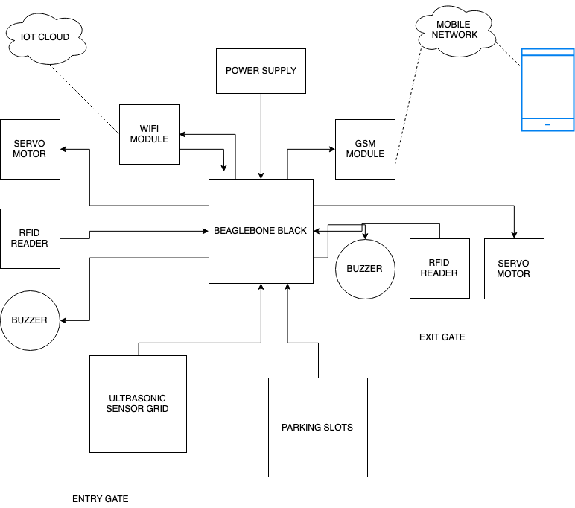
Project Block Diagram

Slide 4
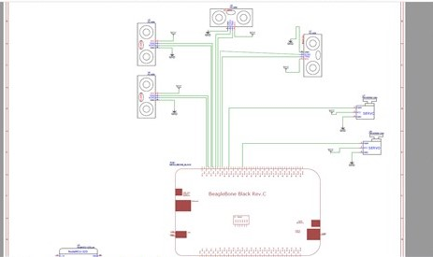
Schematics

Slide 5
Requirements
Hardware Tools:
Beaglebone Black
5V Power Adapter
USB Cable
Ultrasonic Sensors
Servo Motor
Buzzer
GSM
RFID READER
WIFI ADAPTER

Slide 6
Contd..
Software Tools:
Windows OS
Eclipse IDE
PuTTY
GCC Compiler
WinSCP

Slide 7
Iobb Library
Iobb allows for easy general-purpose input/output (GPIO), SPI and I2C using the Beaglebone Black (BBB) and other BBB variants such as the BeagleBone Black Industrial and Beaglebone Black Wireless.
This library is also PocketBeagle friendly.
This library is designed to be easy-to-use, it is quite simple, and it allows for reasonably speedy I/O. There is plenty of demo source code too.

Slide 8
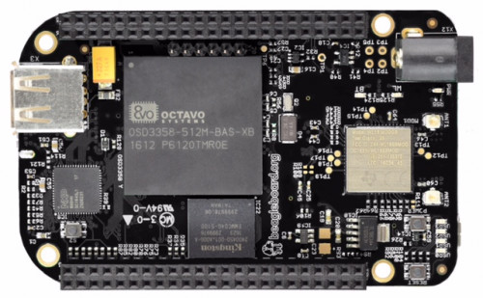
Beaglebone Black

Slide 9
Specifications
Processor:
AM335x 1GHz ARM® Cortex-A8
512MB DDR3 RAM
4GB 8-bit eMMC on-board flash storage
3D graphics accelerator
NEON floating-point accelerator
2x PRU 32-bit microcontrollers

Slide 10
Contd..
Software Compatibility:
Debian
Android
Ubuntu
Cloud9 IDE on Node.js w/ BoneScript library

Slide 11
Contd..
Connectivity:
USB client for power & communications
USB host
Ethernet
HDMI
2x 46 pin headers

Slide 12
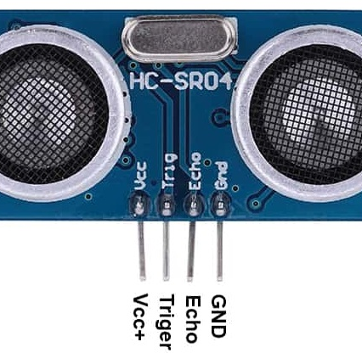
Ultrasonic Sensors

Slide 13
Features
Features:
Power Supply :+5V DC
Quiescent Current : <2mA
Working Current: 15mA
Effectual Angle: <15°
Ranging Distance : 2cm – 400 cm/1" ­ 13ft
Resolution : 0.3 cm
Measuring Angle: 30 degree
Trigger Input Pulse width: 10uS
Dimension: 45mm x 20mm x 15mm

Slide 14
Specifications
Model Number: HC-SR04
Ultrasonic ranging module HC - SR04 provides 2cm - 400cm non-contact measurement function, the ranging accuracy can reach to 3mm.
Basic Working Principle:
Using IO trigger for at least 10us high level signal.
The Module automatically sends eight 40 kHz and detect whether there is a pulse signal back.
IF the signal back, through high level , time of high output IO duration is the time from sending ultrasonic to returning. Test distance = (high level time × velocity of sound (340M/S) / 2

Slide 15
Contd..
Pin 1, Vcc, The Vcc pin powers the sensor, typically with +5V
Pin 2, Trigger, Trigger pin is an Input pin. This pin has to be kept high for 10us to initialize measurement by sending US wave.
Pin 3, Echo, Echo pin is an Output pin. This pin goes high for a period of time which will be equal to the time taken for the US wave to return back to the sensor.
Pin 4, Ground, This pin is connected to the Ground of the system.

Slide 16
Eclipse IDE
Eclipse is an integrated development environment (IDE) used in computer programming.
It contains a base workspace and an extensible plug-in system for customizing the environment
We have used Eclipse IDE as a text editor in this project.

Slide 17
PuTTY
PuTTY is a free and open-source terminal emulator, serial console and network file transfer application.
It supports several network protocols, including SCP, SSH, Telnet, rlogin, and raw socket connection.
It can also connect to a serial port.
The name "PuTTY" has no official meaning.

Slide 18
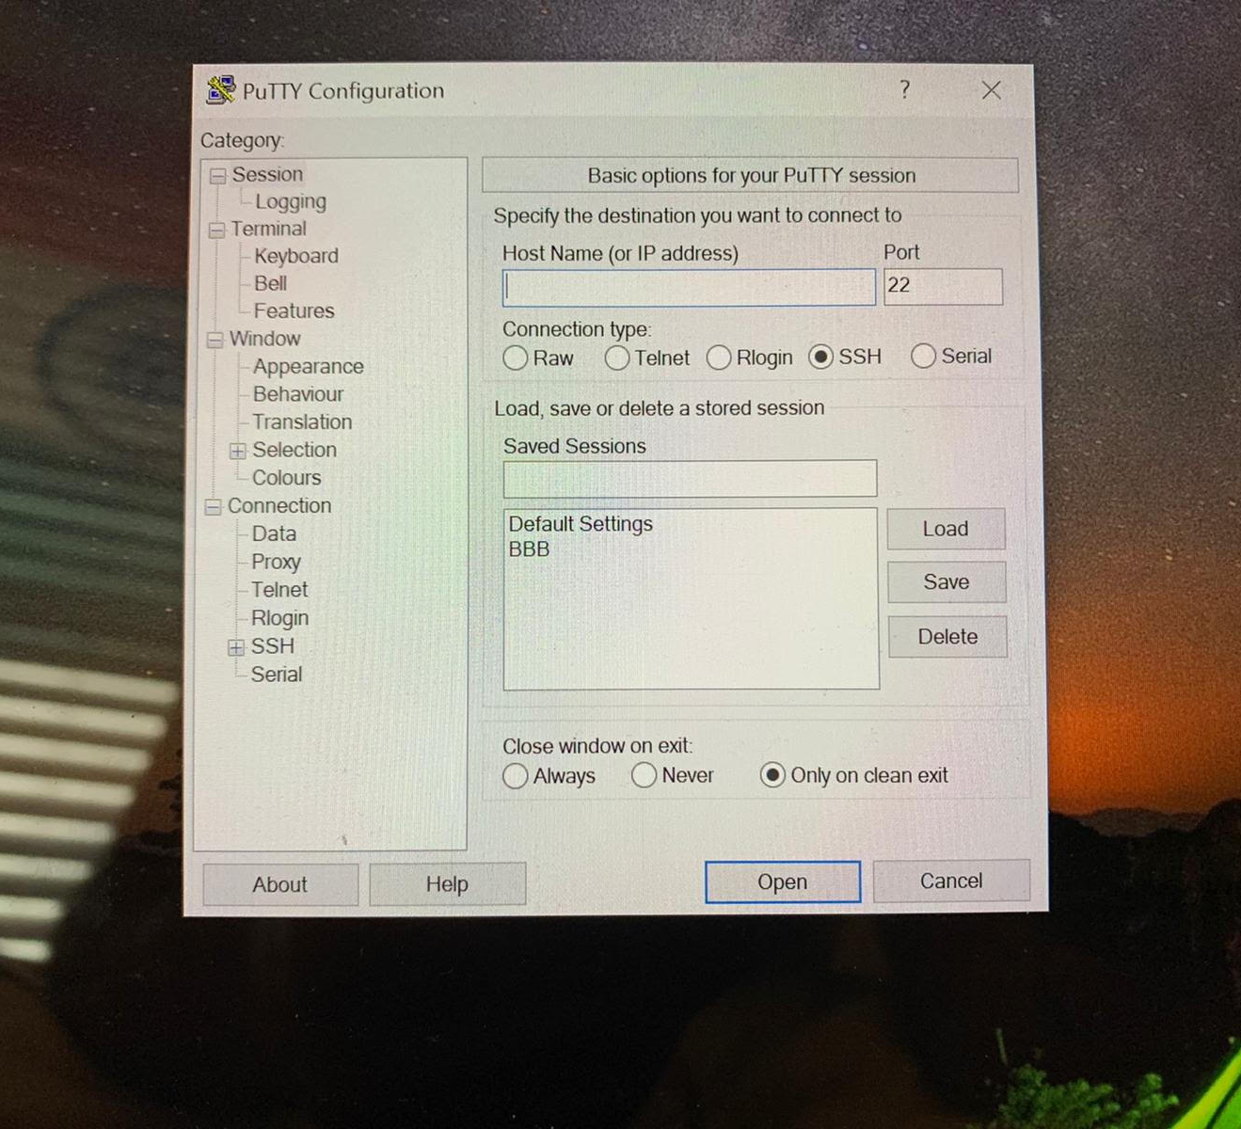
Connect to Beaglebone
PuTTY requires Host name or IP address of the machine we want to connect, the port number and the connection type.
For the connection, the host name will be 192.168.7.2
The port number is default 22
The connection type will be SSH

Slide 19
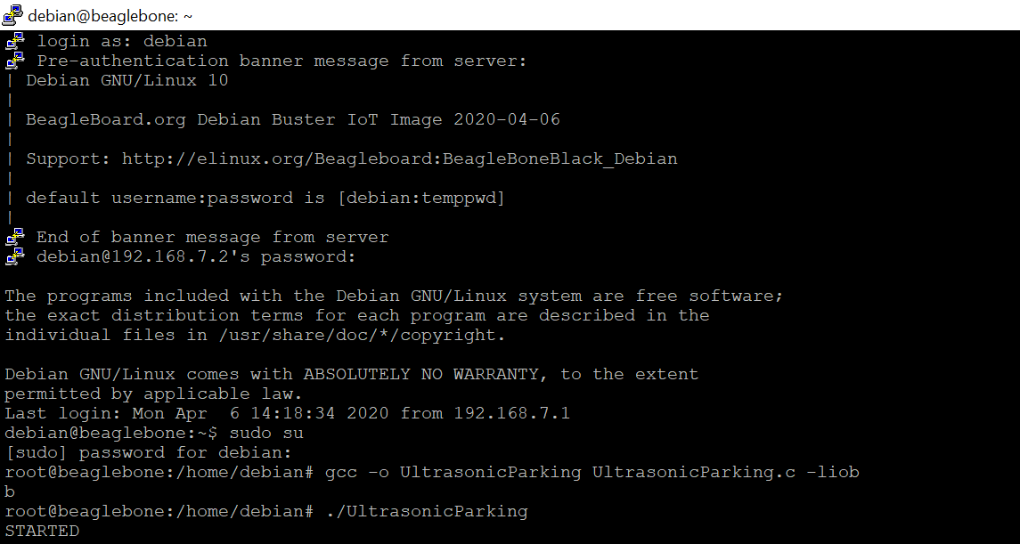
Program Execution
The program is made in the C language
The program is executed in the Debian
GCC compiler is used to compile the program
The commands used in the PuTTY are similar to those used in the Linux terminal as both are executed in the Debian.

Slide 20
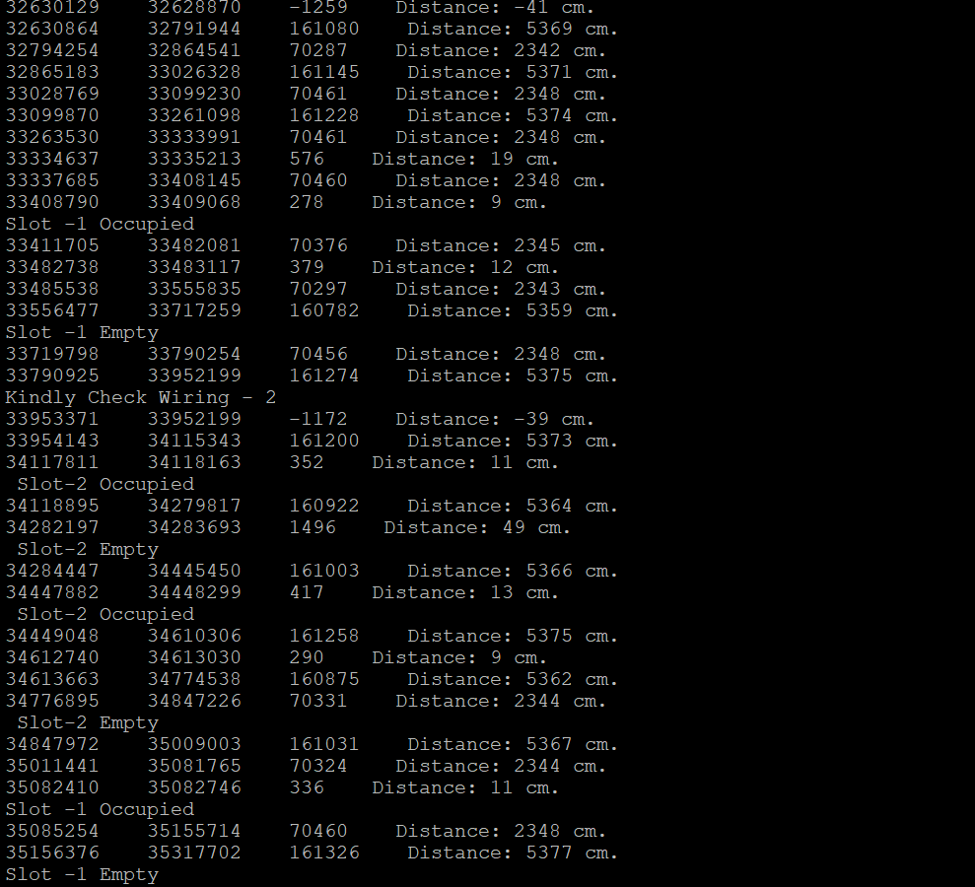
Result

Slide 21
WinSCP
WinSCP is an open source free SFTP client, FTP client, WebDAV client, S3 client and SCP client for Windows. Its main function is file transfer between a local and a remote computer.
Beyond this, WinSCP offers scripting and basic file manager functionality.

Slide 22
Features of WinSCP
Shares site settings with PuTTY
Graphical user interface (screenshots)
Translated into many languages
Integration with Windows (drag drop, URL, shortcut icons, jump list)
All common operations with files
Support for SFTP and SCP protocols over SSH and FTP and WebDAV and S3 protocols.

Slide 23
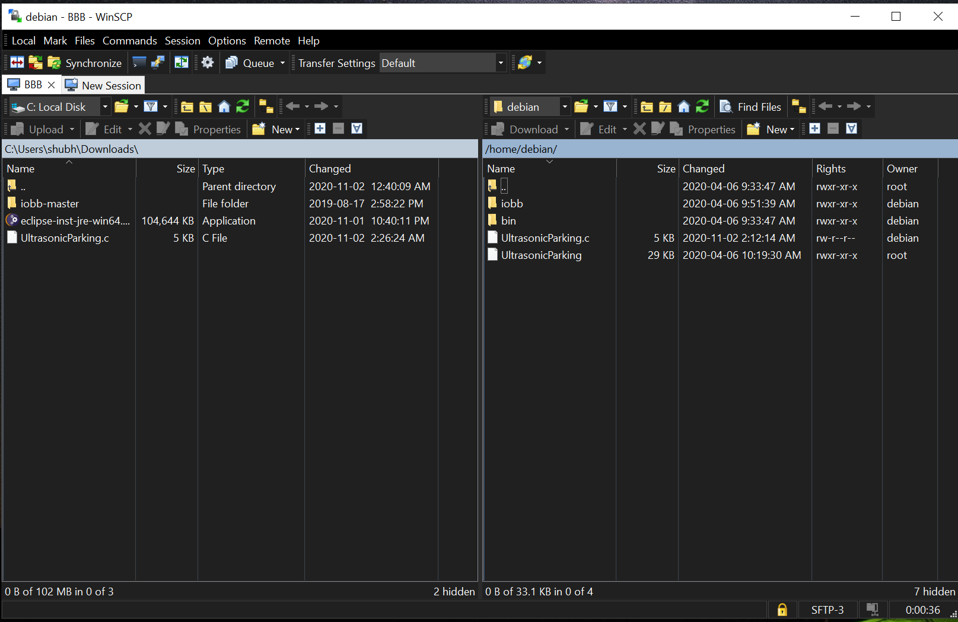
File Transfer
When you start WinSCP, the program will ask you for your login information. In most cases, you will only need to select the server’s protocol, enter the host name, username, and password, and then click Login.
The program will open a directory window like Windows File Explorer.

Slide 24
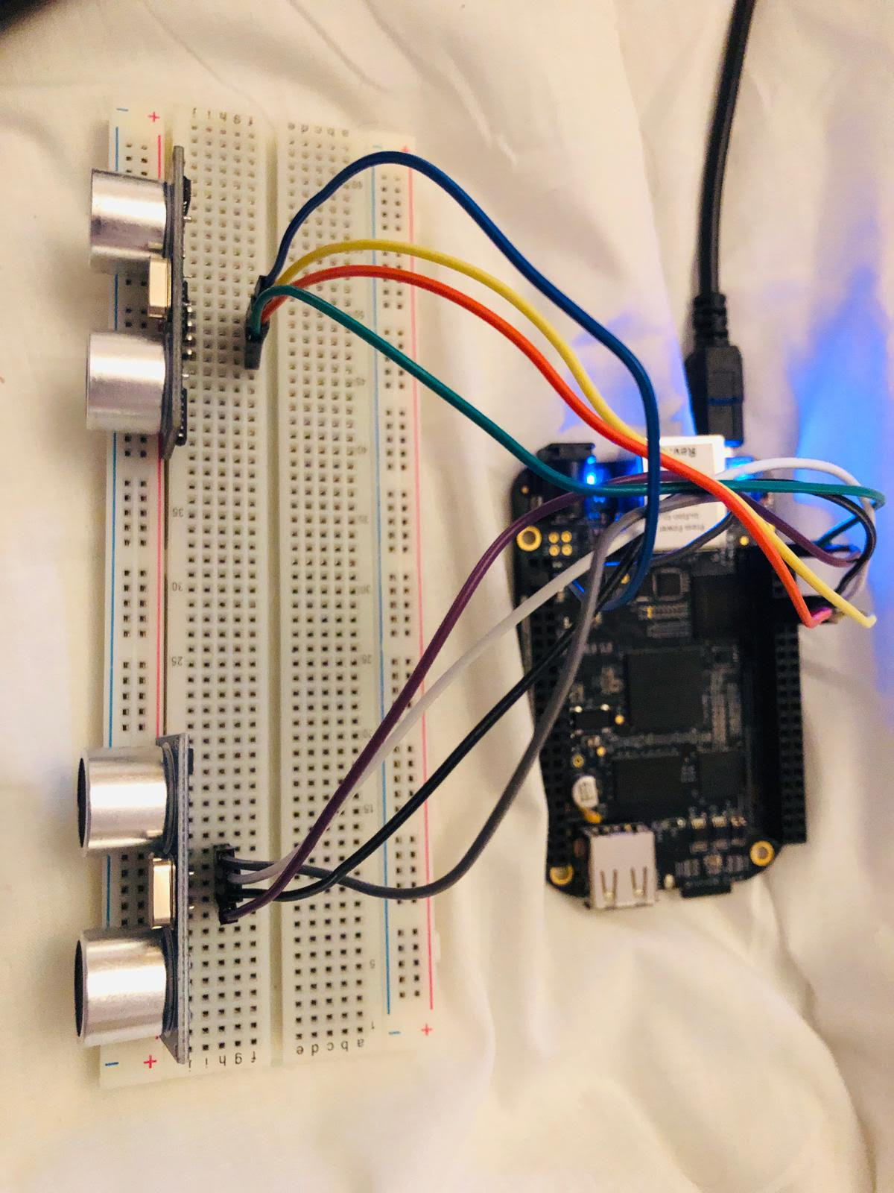
Interfacing

Slide 25
Pin Configuration
The interfacing of the ultrasonic sensors with the Beaglebone black is done through digital logic.
The pins of the ultrasonic sensors are directly connected to the GPIO pins of the Beaglebone black.
To interface the sensors, pins 9, 10, 11 and 12 of P8 of the Beaglebone are used
Each sensor uses 2 pins of the Beaglebone for communication.
Pin 3 and 4 of P9 are used as the power supply to the sensors.

Slide 26
Contd..
The ultrasonic sensors have 4 pins:
VCC = +5VDC
Trig = Trigger input of Sensor
Echo = Echo output of Sensor
GND = GND
For sensor 1, the trigger pin is connected to the pin 10 of the Beaglebone. The echo pin is connected to the pin 9.
Similarly, for sensor 2, the the trigger pin is connected to the pin 12 of the Beaglebone. The echo pin is connected to the pin 11.
The VCC pins are connected to pins 3 and 4 of the Beaglebone.

Slide 27
Working
A +5V supply is given to both the sensors from Beaglebone.
The input and output pins of the sensors are connected to the Beaglebone.
The pins are also initialised in the C program.
Sensor 1 is made to start first in the code and sensor 2 functions later.
Loops are used so that the sensors work continuously.
The code is executed and run in the Beaglebone itself.

Slide 28
Issues while interfacing
As the jumper cables are not soldered yet, the output is sometimes irregular due to improper connection.
A lot of commands were to be used to move the iobb library and the code to the Beaglebone black. But, this drawback was later outcome by WinSCP.
If the computer restarts or shuts down, the PuTTY needs to be connected again and the commands are not saved as in Linux terminal.
We needed to flash the Beaglebone before interfacing.

Slide 29
Conclusion
The ultrasonic sensors and the Beaglebone black can be directly interfaced by digital logic.
We used 2 ultrasonic sensors for interfacing.
The programming language used is C.
WinSCP and the PuTTY are the main software used.
Iobb is the library specially designed for Beaglebone use.

Slide 30
References
beaglebone black. (2019, September 06). Retrieved from beagleboard: https://beagleboard.org/black
hc-sro4 sensors datasheet. (2013, May). Retrieved from elecparts101: https://www.elecparts101.com/wp-content/uploads/2019/09/HC-SR04.pdf
Shabaz. (2019, August 15). iobb library. Retrieved from element14: https://www.element14.com/community/community/designcenter/single-board-computers/next-genbeaglebone/blog/2019/08/15/beaglebone-black-bbb-io-gpio-spi-and-i2c-library-for-c-2019-edition
Teknoman117. (2013, April 13). interfacing beaglebone black with ultrasonic sensor. Retrieved from teknoman.117.wordpress: https://teknoman117.wordpress.com/2013/04/30/using-a-beaglebone-with-an-hc-sr04-sonar/
https://winscp.net/eng/docs/start
https://github.com/shabaz123/iobb
https://www.putty.org/

